Slide 1
Test Report
Media Analytics Report
28/02/2023

Slide 2
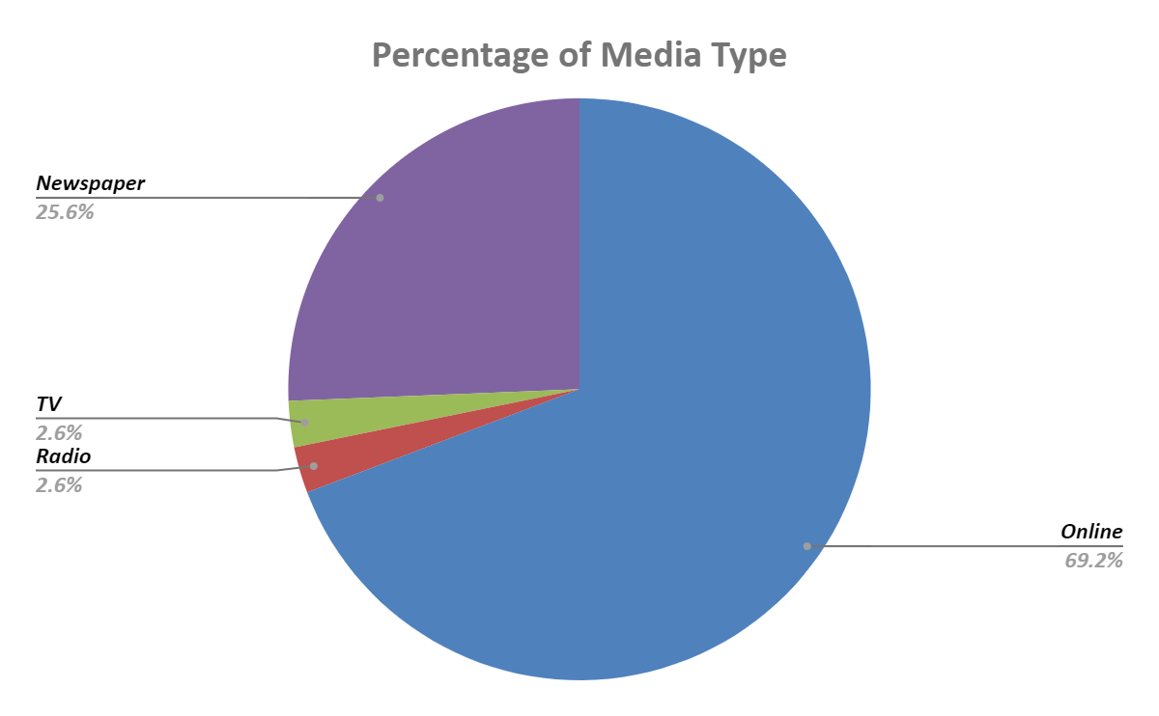
Pie Chart
Observation
1. There are 4 sources of the news.
2. Top 2 news can be found Online and from Newspaper.
3. 1 news each comes from TV and Radio.

Slide 3
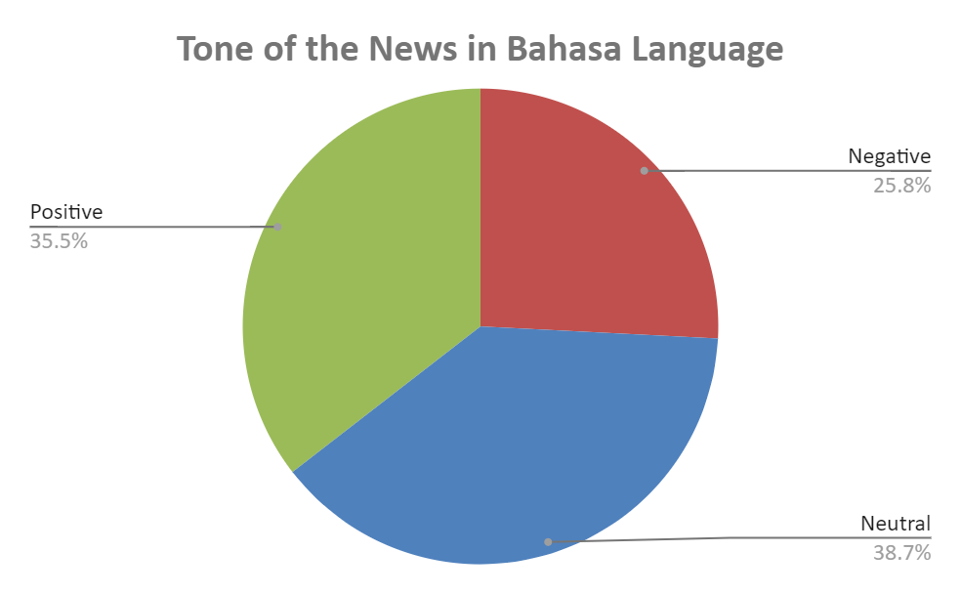
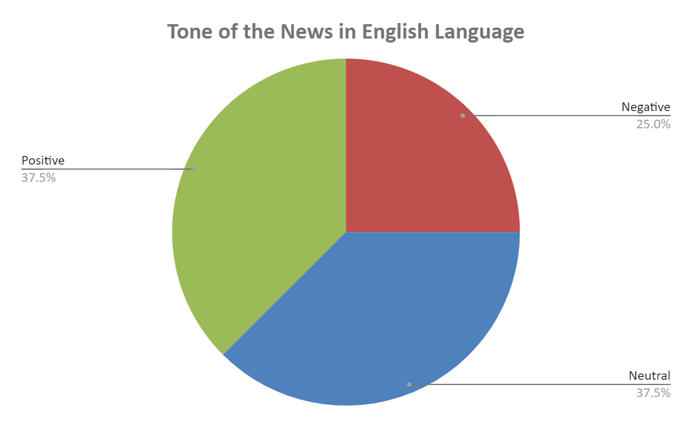
Pie Chart
Observation
News in both Bahasa and English are mostly neutral and positively toned.

Slide 4
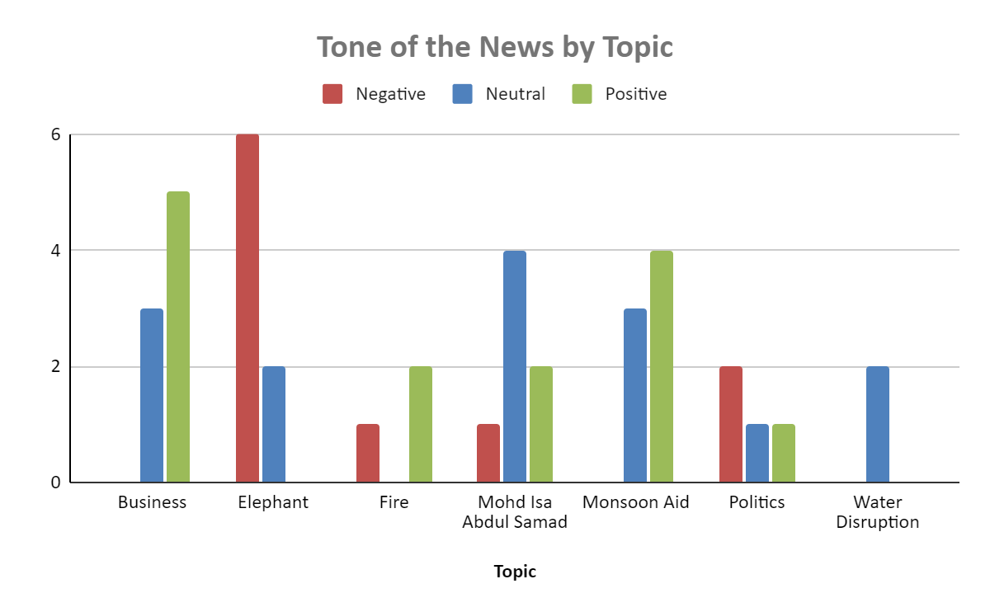
Bar Chart
Observation
1. There are 7 unique topics for the news.
2. Most of the news for Business and Monsoon Aid topics are neutral and positively toned.
3. Business expansion indicates growth, so the news mostly have positive tone.
4. Financial aids can help people affected by the monsoon, so it helps lessen their burden and shows hope and compassion.
5. For Elephant topic, the people affected expressed anxiousness for their safety and the crops they planted in the news.
6. For Fire topic, the news mentioned people being anxious upon realizing the fire, but some news mentioned the firefighters being able to put out the fire.
7. Politics has 2 negatively toned news. 1 is neutral and 1 is positively toned.
8. For Water Disruption and Mohd Isa Abdul Samad topics, most news are neutral toned.

Slide 5
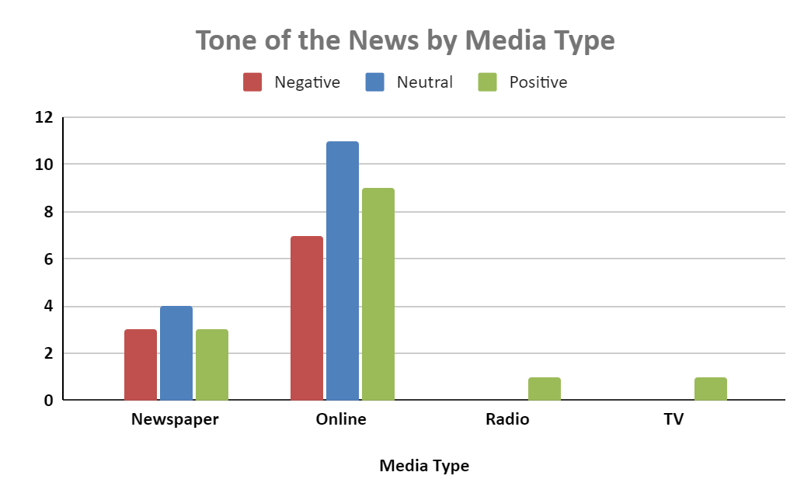
Bar Chart
Observation
1. News online are mostly neutral toned followed by positive and lastly negatively toned.
2. In newspaper, more news are positively toned.
3. Radio and TV have neutral toned news.
4. Top 2 news sources are online and newspaper.

